Slide 1

The Difference Between Champs and Chumps is Defense!
Sydney Scaccia
Final Project Presentation and Analysis

Slide 2

Offense vs Defense

Slide 3
Research Question: Does defense impact a team’s win percentage?

Slide 4




Slide 5
Dependent Variable: Win Percentages
Independent Variable : Total Points and Points Allowed
Null Hypothesis: Defense does not impact a team’s win percentage
Alternative Hypothesis: Defense does impact a team’s win percentage

Slide 6
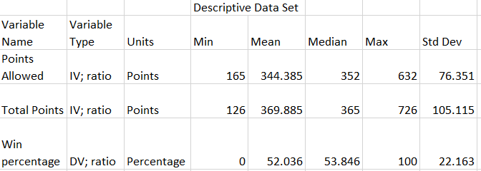

Slide 7
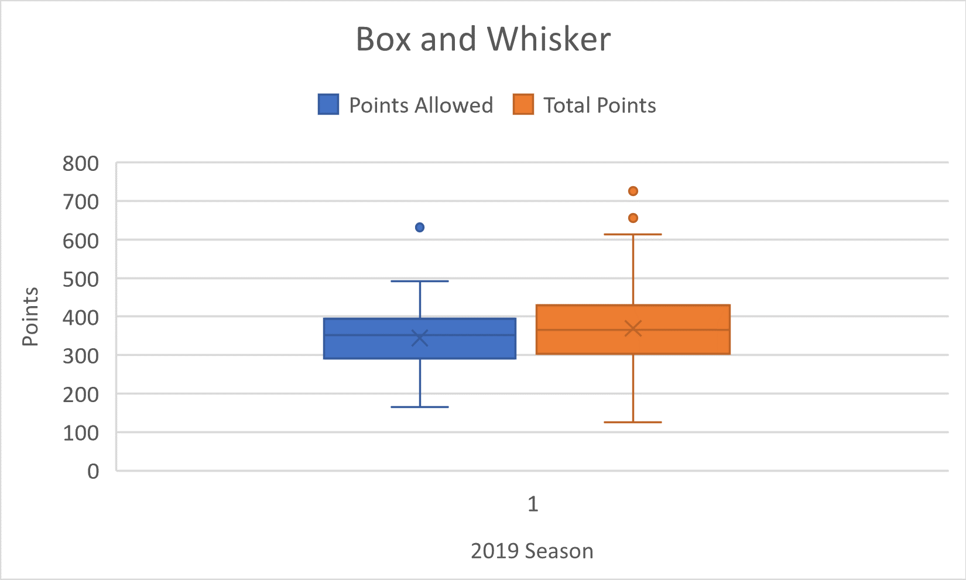

Slide 9
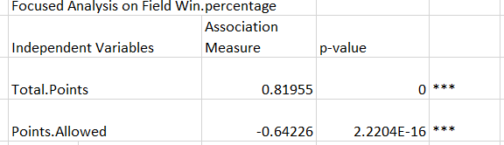

Slide 10
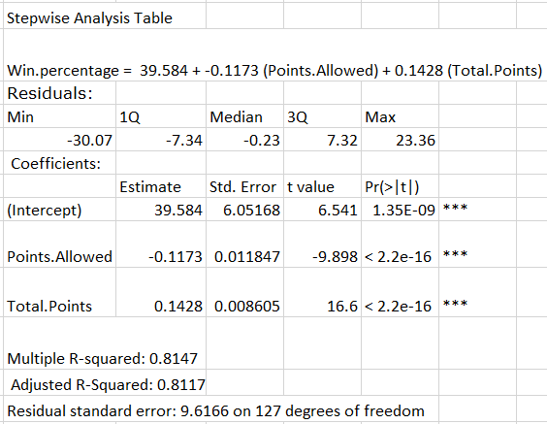

Slide 11
Conclusions
Reject the Null Hypothesis
Accept the Alternative Hypothesis: Defense does impact a team’s win percentage
Possible Type I Error

Slide 12

“The most successful teams come from ones that have their top players play a well-rounded game”
(Pierson, 2018)

Slide 13

“Playing with a solid defense on the court increases the team’s win percentage by 2.1 percent as opposed to having a strong offense alone.”
(The Stats Zone, 2016)

Slide 14
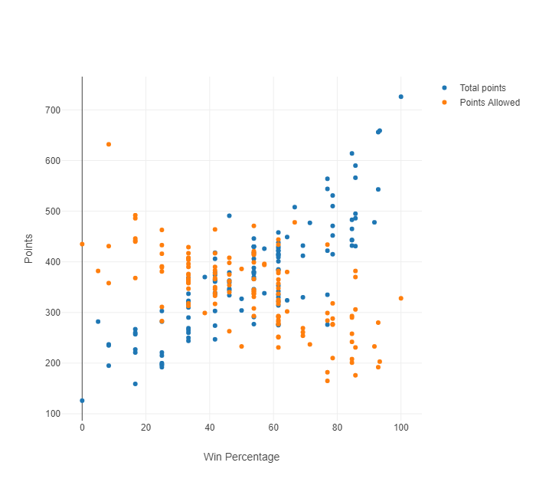

Slide 15
Potential Issues, Social Responsibilities, and Unethical Analysis
Type I Error
Omitted Variable Bias
Multicollinearity
Exploring Beyond the Data
(Wheelan, 2014)

Slide 16
Future Analysis
Include multiple data sets
Expand the number of sports

Slide 17
References
Gallini, J. (2020). College football team stats 2019. https://www.kaggle.com/jeffgallini/college-football-team-stats-2019.
Pierson, B. (2018, January). "Defense Wins Championships" Proves True in Hoops. Retrieved September 18, 2020, from https://247sports.com/college/ucla/Article/Defense-Wins- Championships-Proves-True-in-College-Hoops-and-at-UCLA- 113782988/
The Stats Zone. Does Defence Win Championships? (2016). https://www.thestatszone.com/archive/does-defence-win- championships-14048.
Wheelan, C. J. (2014). Naked statistics: Stripping the dread from the data. New York: W.W. Norton.

